Slide 1
Students’ Activism Towards
Environmental Conservation
in the Philippines
Prepared by:
Eric Adrian Javier Panting
BS in Agribusiness Management
Department of Agribusiness Management
College of Economics and Management
University of the Philippines Los Baños

Slide 2
Presentation Outline
Introduction
The Philippines: Environmental Status
Students’ Role for the Environment
Student Organizations for the Environment: UPLB
Student Campaigns/Programs/Activities for the Environment
Analysis and Problems
Conclusion

Slide 3
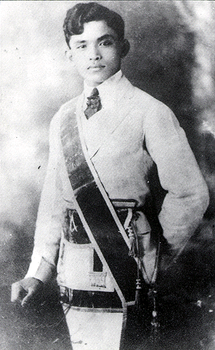
Introduction
“The youth is the hope of our future.”
-Dr. Jose P. Rizal (1861 – 1896)
Philippine National Hero

Slide 4
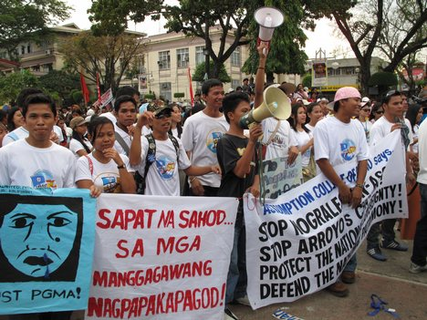
Introduction
Redefining
ACTIVISM
(I, myself, will act for my country)

Slide 5
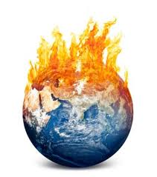
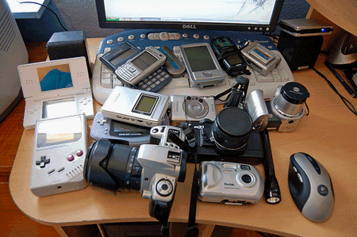
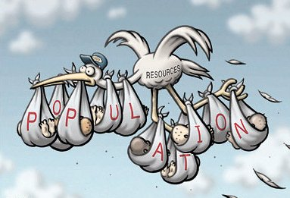
Introduction
Technological advancement
Global warming
Over-population

Slide 6
The Philippines:
Environmental Status
Source: http://rainforests.mongabay.com/deforestation/2000/Philippines.htm

Slide 7
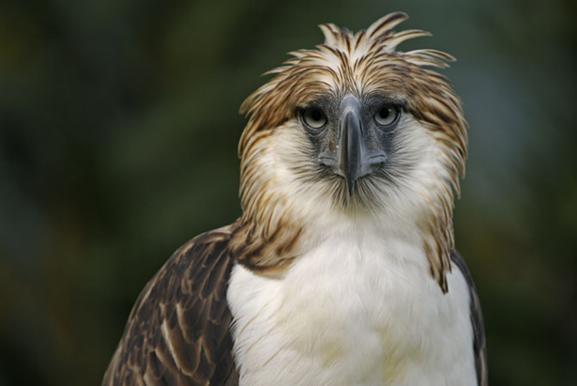
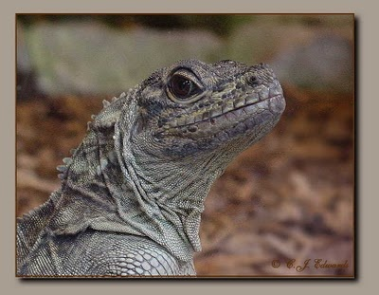
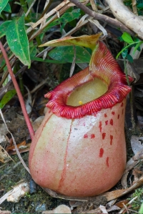
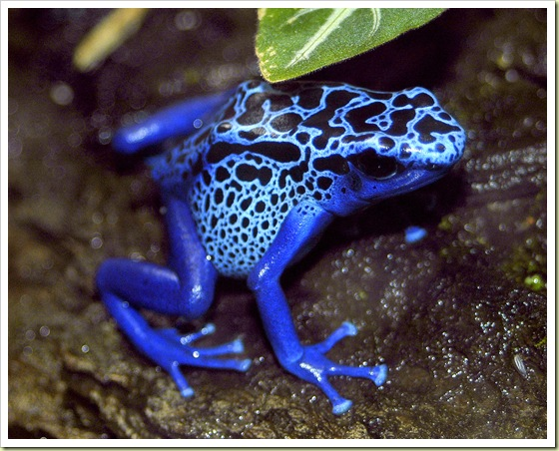
The Philippines:
Environmental Status
Table 1. Philippines: Biodiversity, 2006
 | Amphibians | Birds | Mammals | Reptiles | Plants
total species | 110 | 590 | 222 | 274 | 8931
endemic species | 77 | 205 | 106 | 160 | 3500
threatened species | 48 | 70 | 50 | 8 | 212
Source:http://rainforests.mongabay.com/deforestation/2000/Philippines.htm

Slide 8
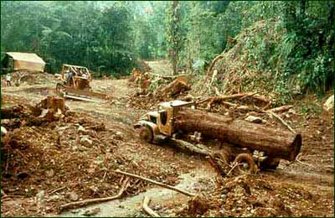
The Philippines:
Environmental Status
Illegal logging

Slide 9
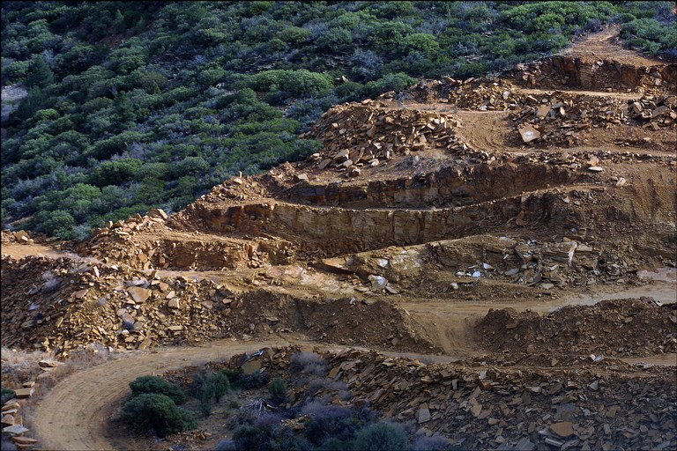
The Philippines:
Environmental Status
Mining

Slide 10
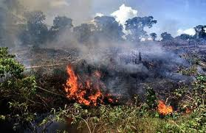
The Philippines:
Environmental Status
Agricultural fires

Slide 11
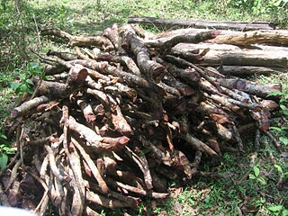
The Philippines:
Environmental Status
Fuel wood collection

Slide 12
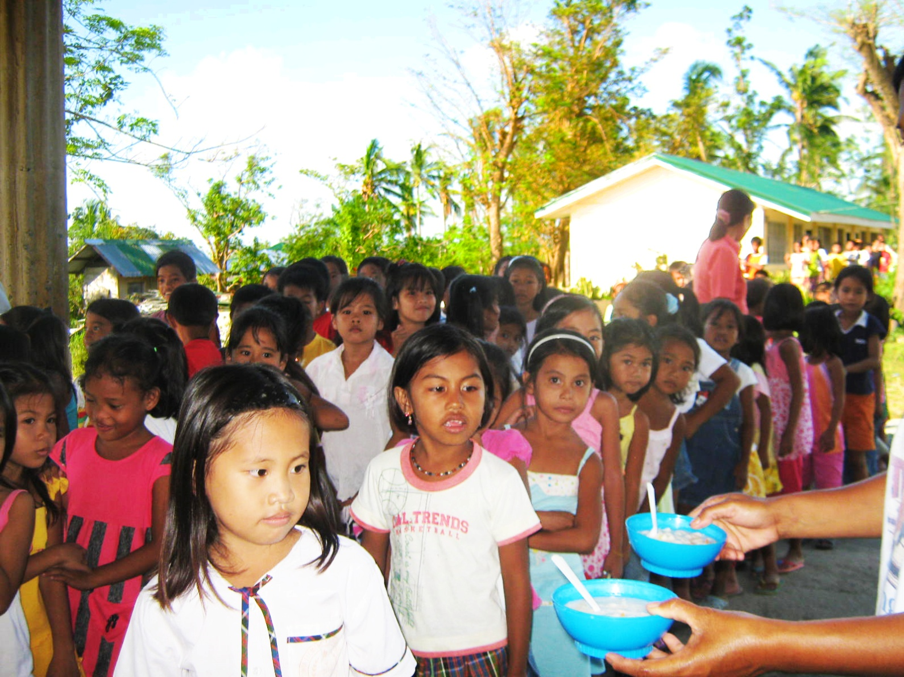
The Philippines:
Environmental Status
Rural Population growth

Slide 13
Students’ role
for the environment
hope of the nation’s future
most powerful stratum of the society
must be more proactive and cooperative with environmental concerns

Slide 14
Today’s student is tomorrow’s citizen…
Students’ role
for the environment
more access to information
efficient communication skills
training, expertise, specialization
fresh and creative minds

Slide 15
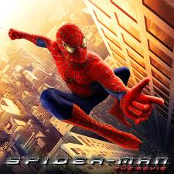
Students’ role
for the environment
“With great POWER, comes great RESPONSIBILITY.”
- Spiderman (2002)

Slide 16
Then what are the actions of Filipino students, particularly UP students, to the prevailing environmental crisis?
Students’ role
for the environment
Are UP students environmentally active?

Slide 17
Haring Ibon UPLB
Student Organizations
for the Environment: UPLB
civic-environmental organization
promotes sustainable development
battle against environmental degradation

Slide 18
Haring Ibon UPLB
Student Organizations
for the Environment: UPLB
print campaign shirts, conduct exhibits, body painting
campaigns include:
ISKOLASTIK (Iskolar Laban sa Styro at Plastik)
No to poaching
Stop Global Warming
Conserve water
ecological camp (ECOCAMP)
publishing of official newsletter, Plumahe
Junior Paberdehan/Ecological Quiz Contest
Tree GROWING
“Blue Day” and PulotKalat activity

Slide 19
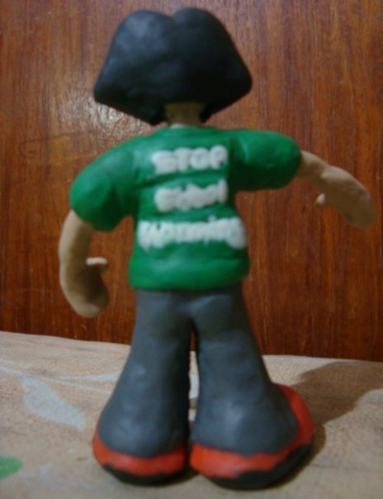
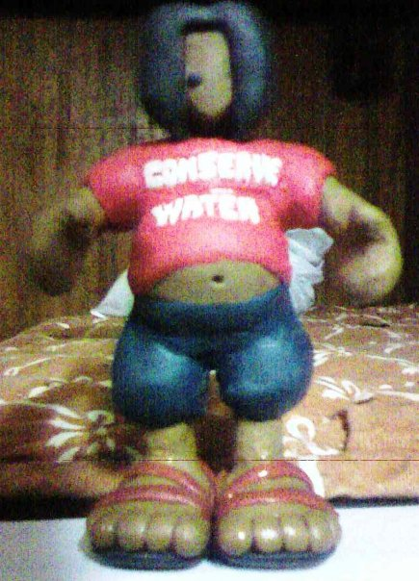
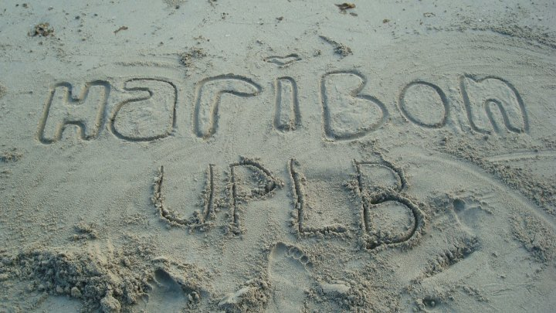
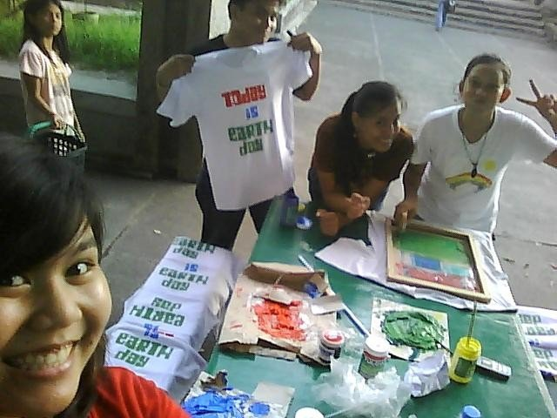
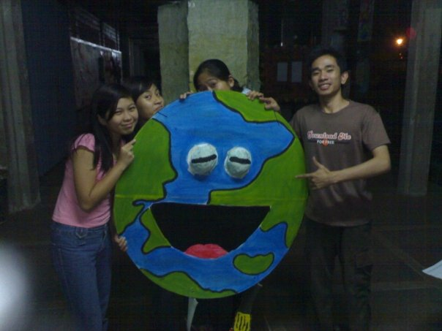
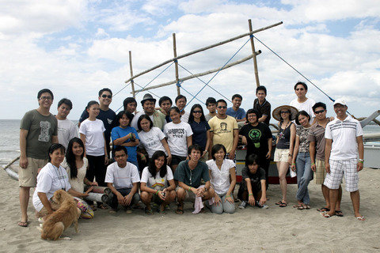
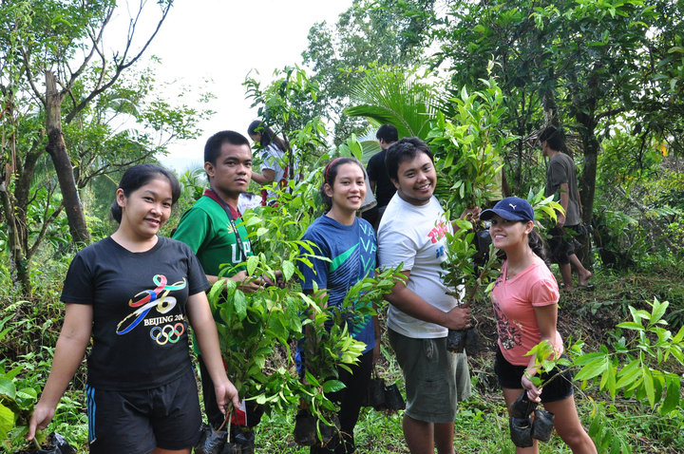
Student Organizations
for the Environment: UPLB

Slide 20
Other organizations include…
Student Organizations
for the Environment: UPLB
Association of Filipino Forestry Students – UPLB (AFFS-UPLB)
Samahang Ekolohiya ng UPLB (SAMAEKO)
UPLB Forestry Society

Slide 21
The UP Padyak Project
Student Campaigns/Programs/Activities
for the Environment
promotes use of bicycles as transportation means
offers students bicycles for rent and training clinics
lessen dependence on fossil-fuel driven vehicles
improves health and fitness conditions

Slide 22
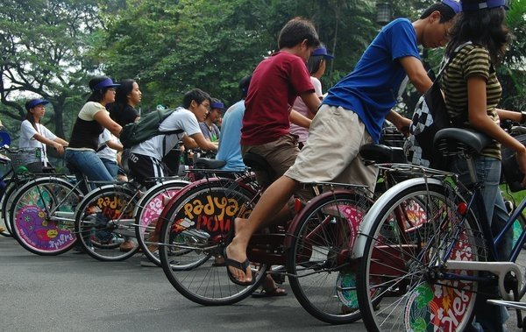
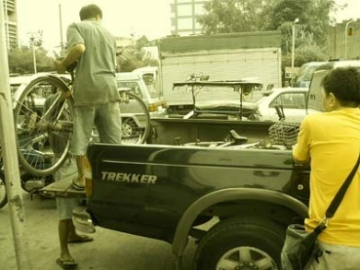
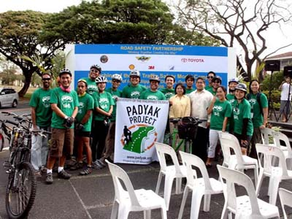
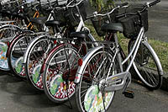
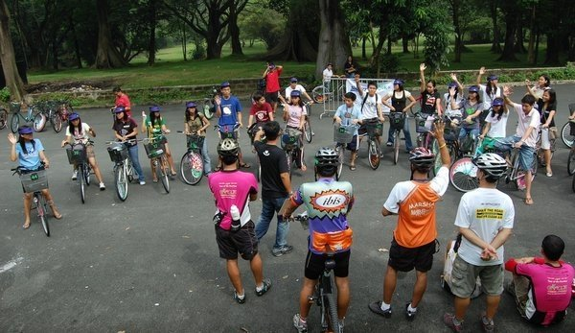
Student Campaigns/Programs/Activities
for the Environment
“to create a UP community that is health conscious and environmentally aware by the alternative mode of transportation”

Slide 23
The UP Padyak Project
Student Campaigns/Programs/Activities
for the Environment

Slide 24
Youth Ecological Camps (YECs)
Student Campaigns/Programs/Activities
for the Environment
Los Baños Forest Club
Department of Social Development Services, College of Human Ecology (DSDS-CHE), UPLB
Samahan ng mga Mag-aaral ng Teknolohiyang Panlipunan (SMTP)

Slide 25
Youth Ecological Camps (YECs)
Student Campaigns/Programs/Activities
for the Environment
three day ecological camp
twenty high school students participated
conservation of Laguna Lake

Slide 26
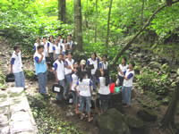
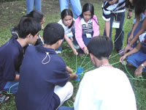
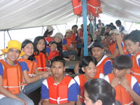
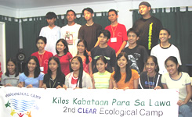
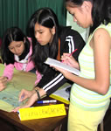
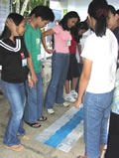
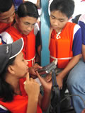
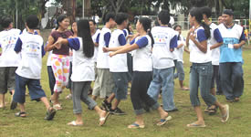
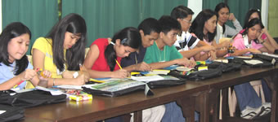
Student Campaigns/Programs/Activities
for the Environment
“A lake that is thriving with life nurtured by a caring community working together to sustain its life support functions for the present and future generations”

Slide 27
Bring-Your-Own-Bag (BYOB) Campaign
Student Campaigns/Programs/Activities
for the Environment
No Plastics Policy?
Bring your own bag!
Waste Disposal Problems
R.A. 9003
conducted by eleven graduate students of MS Development Communication
GOAL: to enhance awareness of people regarding the dangerous effects of ill-disposed plastics

Slide 28
Bring-Your-Own-Bag (BYOB) Campaign
Student Campaigns/Programs/Activities
for the Environment
a class project turned entire town campaign
the BYOB campaign includes:
distribution of katsa/coco-cloth bags
airing of informative video
forum and fashion show on bags
selling of button pins with statements

Slide 29
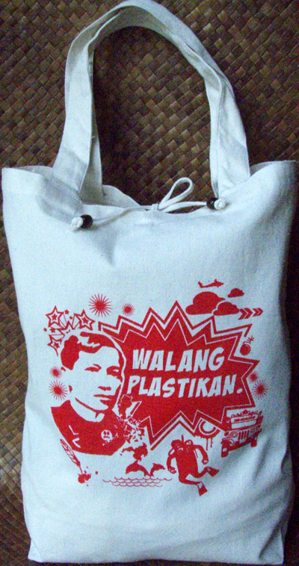
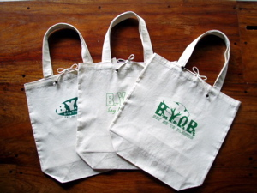
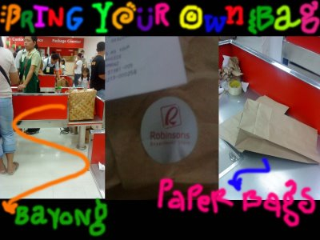
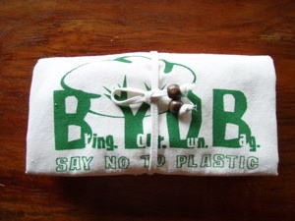
Student Campaigns/Programs/Activities
for the Environment

Slide 30
Analysis and Problems
Students are actively participating with movements towards environmental conservation.
Students tend to inspire and draw more participation into an environmentally-friendly living.
As environmental activists, they do not just promote advocacies but they also start actions within themselves.
They also have a concept of monitoring the outcomes of their activities.

Slide 31
Analysis and Problems
Creativity
Sustainability
Harmony

Slide 32
Analysis and Problems
Problem lies on the collaboration of students and other units/sectors of the society.
There is also a problem on overall participation.
Securing funds for activities also hinder students from achieving environmental goals and objectives.

Slide 33
Conclusion
The environment is facing a huge crisis on sustainability.
There is hope in the presence of the youth, the students.
In order to maximize the potentials of the students, they must work hand-in-hand with the other sectors of the community.
Environmental issues are everybody’s concern and must not be taken for granted.

Slide 34
References
Association of Filipino Forestry Students. 2010. http://en.wikipilipinas.org/index.php?title=Association_of_Filipino_Forestry_Students_-_UPLB
BARONA, M. L. J. 2007. The UPLB Horizon. “BYOB is everybody’s business”. http://www.old.uplb.edu.ph/news/uplb-news/uplb-link/1100
BUTLER, R.A. 2010. "Tropical Rainforest Conservation." Mongabay.com. San Francisco.
CALLEJA, N.C. 2007. Los Baños adopts students’ campaign to reduce plastics use. http://newsinfo.inquirer.net/breakingnews/regions/view/20070926-90872/Los_Ba%F1os_adopts_students%92_campaign_to_reduce_plastics_use
Department of Education. Republic of the Philippines. http://www.deped.gov.ph/cpanel/uploads/issuanceImg/Factsheet2009%20Sept%2022.pdf
DOBLE, R.D. 2003. The World Environmental Crisis Today. http://www.rickdoble.net/world_culture/CrisisToday.htm.
GARCIA, A. G. 2009. Manila Bulletin. ‘Padyak’ All the Way! http://mb.com.ph/node/198666

Slide 35
References
KUNDALIYA. Edited by PERUMPALAM. 2010. http://wiki.answers.com/Q/What_is_the_role_of_students_to_protect_environment.
National Statistic Coordination Board. Republic of the Philippines. http://www.nscb.gov.ph/secstat/d_educ.asp
Society for the Conservation of the Philippine Wetlands, Inc. (SCPW). 2010. Ecological Camp. “Kilos Kabataan Para SaLawa”. http://www.psdn.org.ph/wetlands/activities1b.htm#ecocamp_siniloan.
Special Feature: Young Students Form Environmental Organization. 2008. http://www.scouts.org.ph/global/module.php?LM=news.detail&pid=1223024729592
SUNGA, J.M.C. 2005. The UPLB Horizon. “DSDS-CHE spearheads environment youth camp”. http://www.old.uplb.edu.ph/news/uplb-news/334
The UP PADYAK PROJECT. Bike for UP. Bike for the Environment. What is the UP PadyakProject. http://padyakbikes.multiply.com/
UPLB Student Organizations. 2008. http://wikibin.org/articles/uplb-student-organizations.html

Slide 36
Thank You Very Much!
Maraming Salamat po!
Doumo Arigatou Gozaimasu

