Slide 1
STUDENTS TAKING ACTION: Expanding knowledge
International Students Summit 2010
Sharing in the agriculture, energy and environmental sectors
PERUVIAN STUDENTS AS AGENTS OF CHANGE
Sara Calvo
María Díaz
National Agrarian University-La Molina

Slide 2
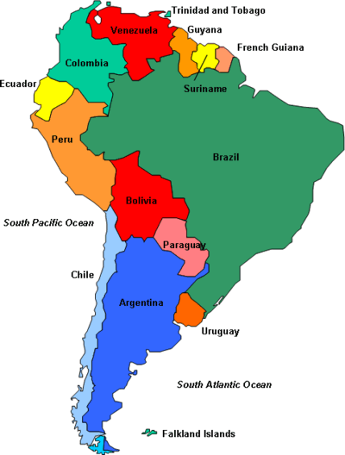
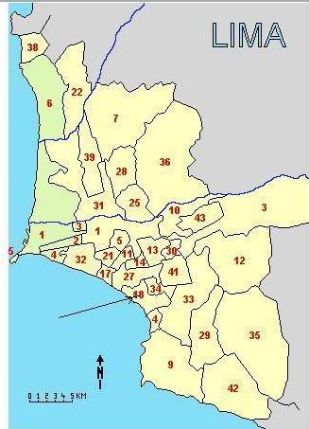
Where is PERU located?
Lima: Capital of Perú
National Agraria University La Molina

Slide 3
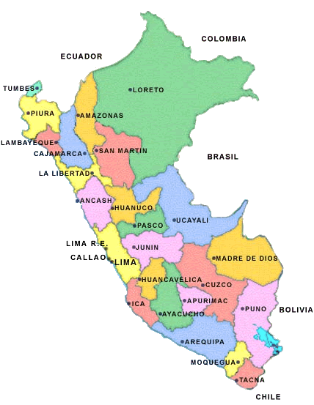
INTRODUCTION
IMPORTANT FACTS OF PERUVIAN POPULATION
On 2007 the population of Peru was 28,220,764
More than one out of four Peruvians are between 15 and 29 years old.
Youth of Peru is now the population group with fastest growing rate and demographic importance in the country.
Only 25%of Peruvians have access to higher education of which 13% is college.

Slide 4
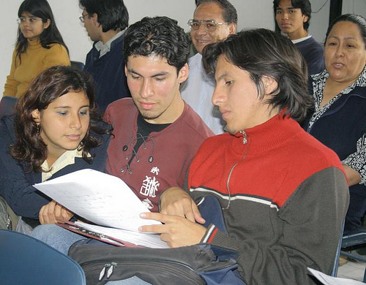
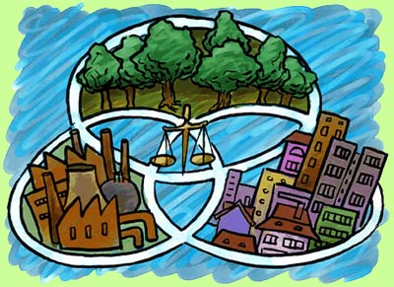
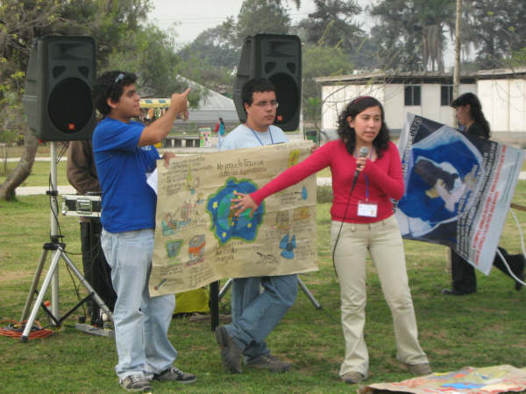
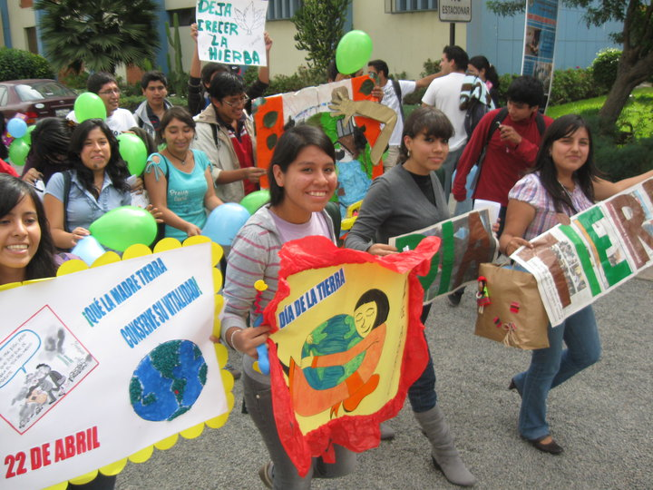
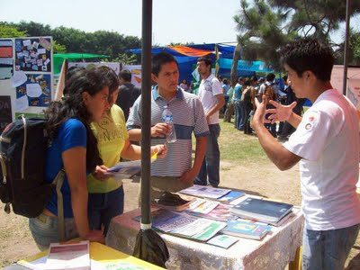
It ‘s important to promote activities from youth associations, thus through their participation the success of various projects proposed by them in pursuit of the sustainable development of our country is possible.
Young people seek to be agents of change starting from the area in which we live every day like our home, our university and our community, however, only the university settings allows us to express our ideas, discuss them and reach the generation of projects.

Slide 5
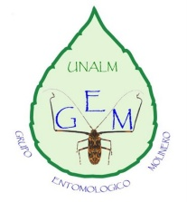
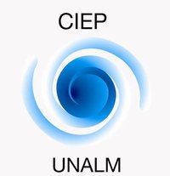
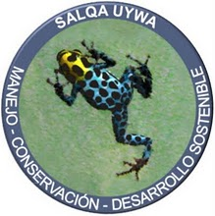
UNALM STUDENTS WORKING FOR A BETTER ENVIRONMENT
CAM
GAV
GEM
RUA UNALM NODE
CIEP
FAUNALM
National Agraria University La Molina
BIO UNALM
SALWA UYWA

Slide 6
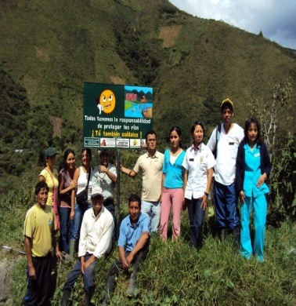
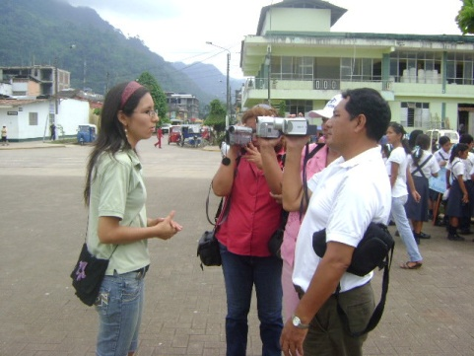
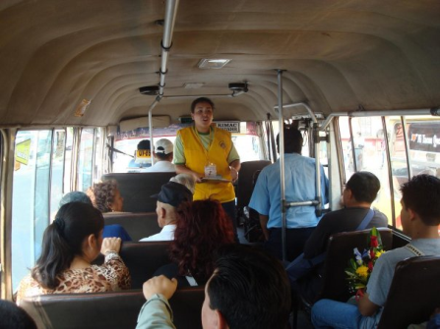
ENVIRONMENTAL UNIVERSITY NETWORK: PERUVIAN STUDENTS TOGETHER
WHAT IS RUA?
The RUA is a national university student’s network.
NODES are involved in activities related to promoting sustainable development and they play a leading role in solutions to environmental problems in the area of influence of each of its members.
RUA is made of groups called NODES
It was created on November 2001 by a group of students who were aware of the role of the universities as a forum for analysis, discussion, and diagnosis and proposes of solutions to environmental problems.

Slide 7
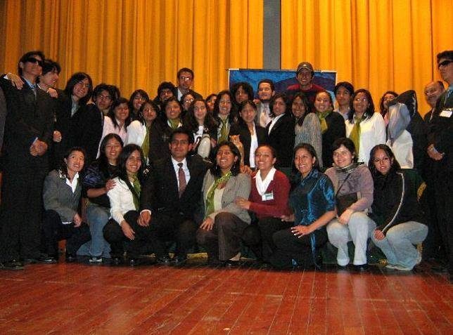
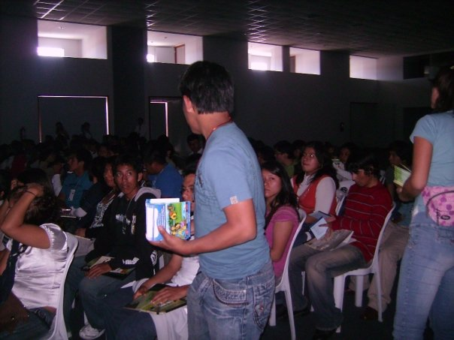
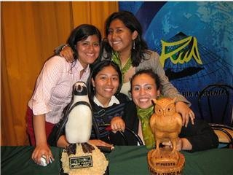
National University and Environment Meeting (ENUMA)
ENUMA is the main event of RUA; annually it takes place in different cities of the country.
An event that addresses issues related to the environment and sustainable development, proposing solutions to fulfill them in projects.

Slide 8
HOW DOES IT WORK?
Nowadays RUA is managed by an administrative council made up of students that direct and supervise the operation of the Network.
UNALM node was created 5 years ago and it is one of the most solid and committed nodes of the network.
Some nodes have greater involvement with the community, that is the case of Amazonian node whose collaboration with their local governments is active, organizing together environmental campaigns. However every member pursues the same and main objectives.

Slide 9
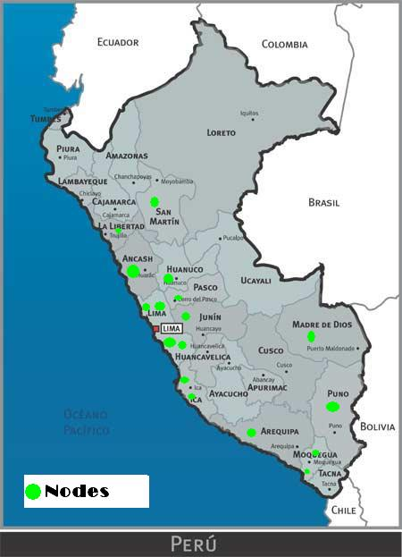
Coming from different parts of the country makes being a member of the network an enriching experience, because of the knowledge we acquire from being multidisciplinary and to be aware of the various faces of the Peruvian reality for being multicultural.
RUA website :
www.ruaperu.org The aim is “The concern and desire of promoting ways that favors the raise of the academic, professional and environmental levels”

Slide 10
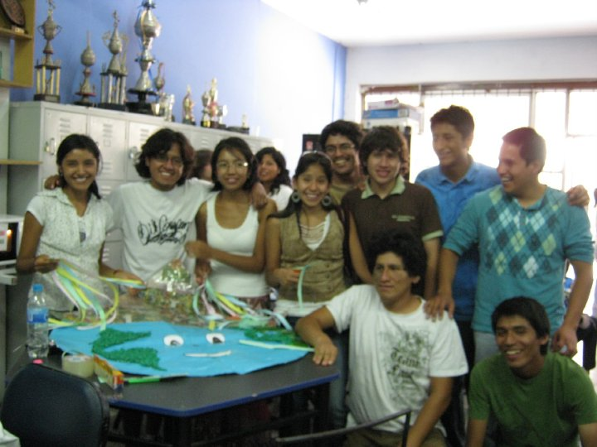
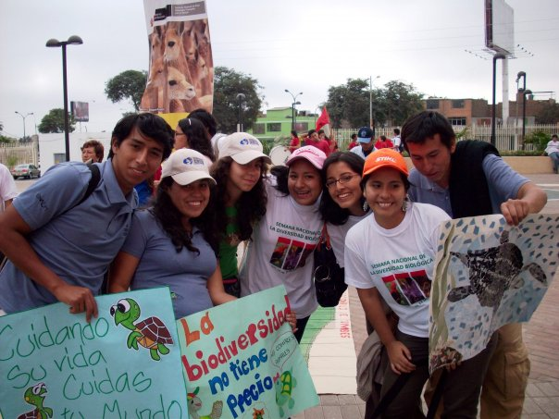
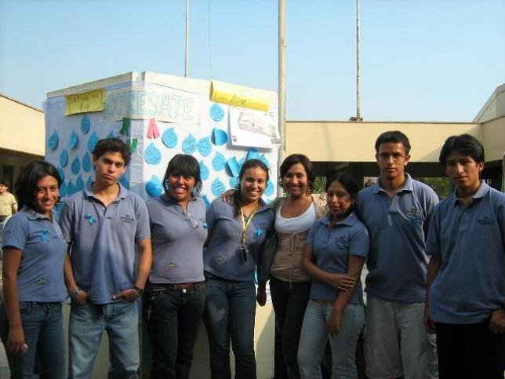
RUA UNALM NODE
workshops
Friendship
Environmental campaings

Slide 11
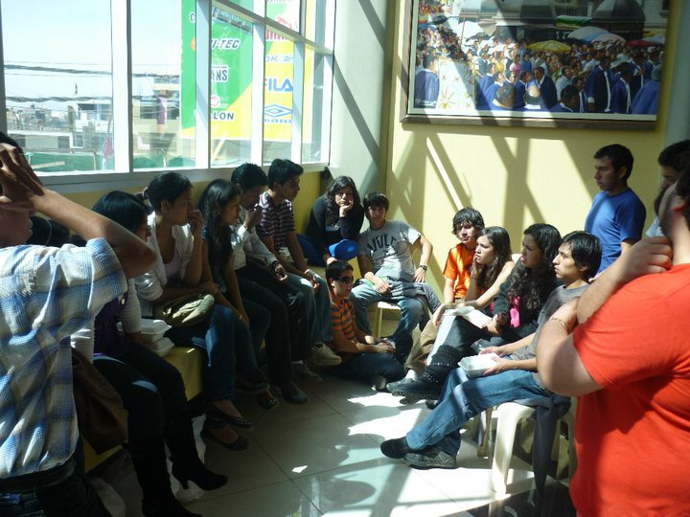
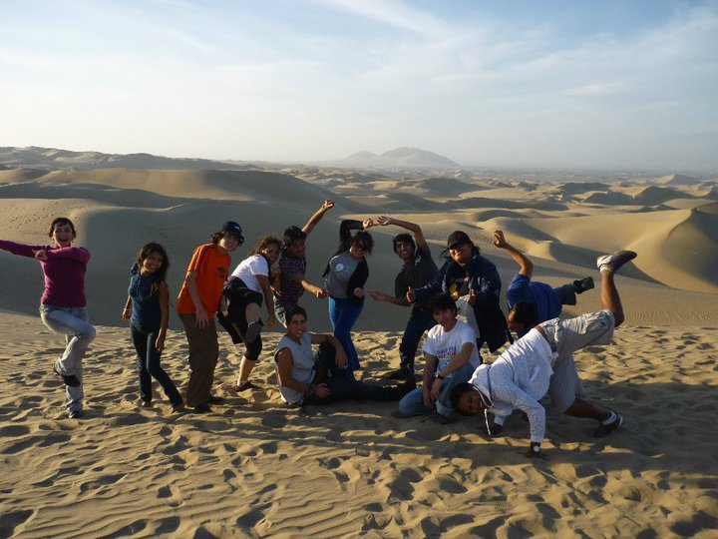
Students meetings
Trips
Pilot Program : Education on roads, with Municipality of Lima
Environmental campaings

Slide 12
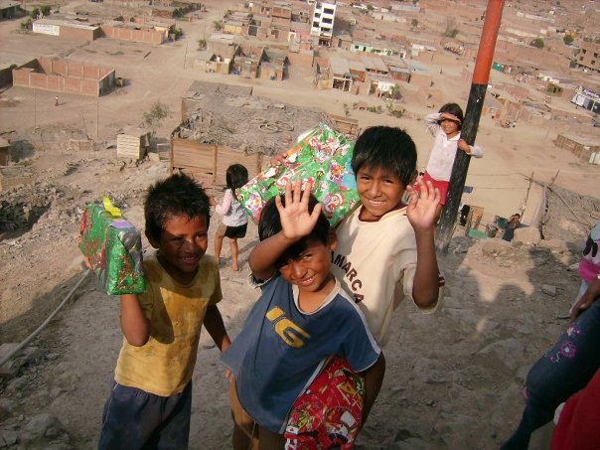
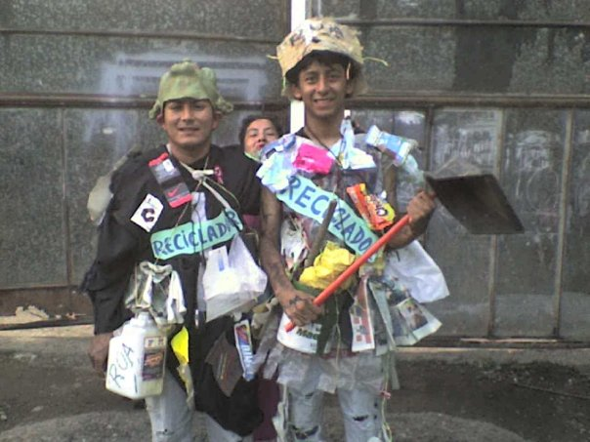
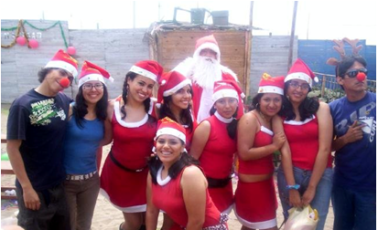
Social work
Awareness

Slide 13
UNALM node activities
Organization of the annual “National Environmental and University Meeting” in 2007.
Campaigns, workshops and seminars according to the environmental calendar
Supporting to other organizations as Municipalities.
Research projects

Slide 14
1
UNALM: Ecoefficient campus
Surveys
2
Participatory diagnosis
4
Elaboration of an environmental policy
Elaboration of an action plan
3
5
Elaboration of local environmental agenda
Sustainable environmental management through the implementation of good environmental practices
6
Implementation

Slide 15
RESEARCH PROJECTS
“Monitoring air quality of the UNALM using the modeling software ISC Aermod View”
“Construction of a mist trap as alternative to the captation of water ”

Slide 16
CONCLUSIONS
Young people in Peru are assuming their role and taking action from their university recognizing that its potential strength can lead to big changes for society.
University groups can be generating sources of projects. It is necessary to orientate them towards researching
In UNALM, this process has been brewing through the existing groups, but it is very important that University seeks their articulation

Slide 17
THANK YOU

